Slide 1
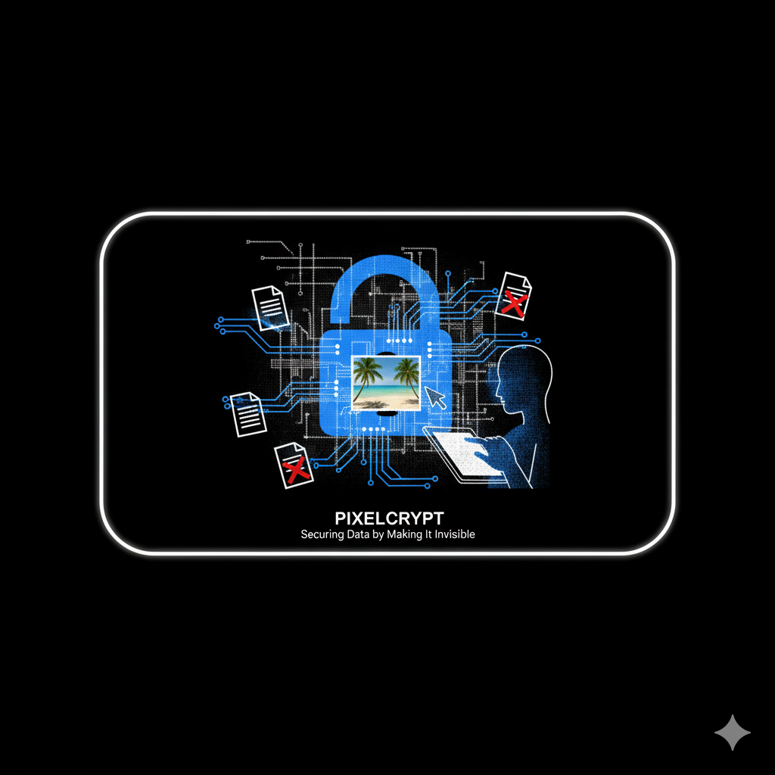
PIXELCRYPT
Securing Data by Making It Invisible
By Varun Kumar
USN : 1BI24MC157

Slide 2
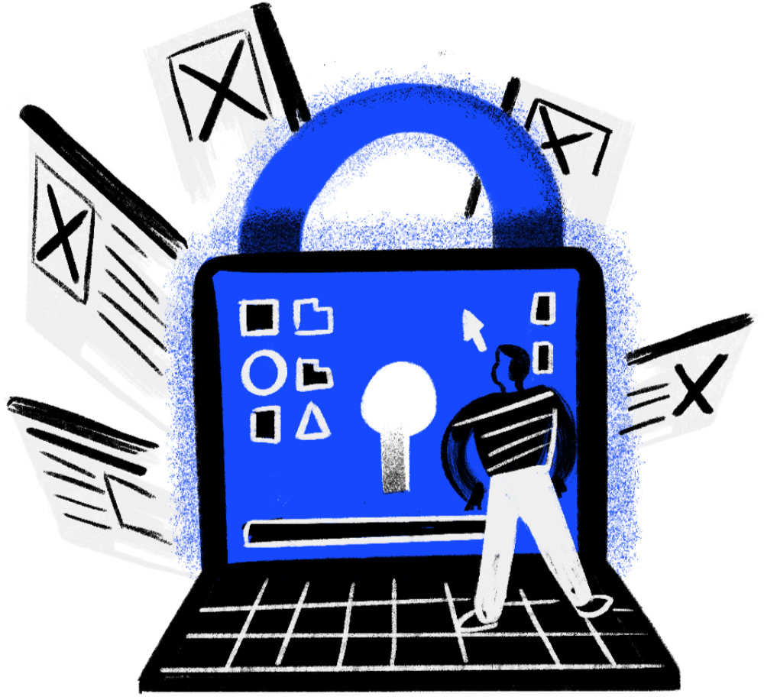
WHY STANDARD ENCRYPTION ISN'T ENOUGH.?
  When you encrypt a file, you're essentially putting it in a digital vault. While the content is secure, the vault itself is obvious. An encrypted file screams, "I contain valuable, secret information!".
  This attracts unwanted attention from anyone monitoring your communications. The encrypted file itself becomes a target for analysis, theft, or demands for decryption.

Slide 3
LITERATURE SURVEY
Current steganography tools force users to choose between powerful but complex command-line utilities and convenient online tools that compromise privacy. This effectively locks secure data hiding away from everyday users, leaving a need for a tool that is both safe and simple. PixelCrypt bridges this divide by integrating strong AES encryption with clever LSB (Least Significant Bit) data hiding into an intuitive interface. It is a modern, offline application that finally makes truly secure and covert communication accessible to everyone.

Slide 4
COMBINING CRYPTOGRAPHY & STEGANOGRAPHY
Our Solution : PixelCrypt uses a two-layer approach for ultimate security.
  Cryptography (The Lock): We first scramble your secret message using a powerful encryption algorithm (AES). This makes the data unreadable without the password.
  Steganography (The Camouflage): Then, we take that scrambled message and hide it inside a normal, everyday file—like an image, video, or audio track. This is the art of data hiding.
To an outsider, there is no secret. There is only a regular file.

Slide 5
THE WORKFLOW: A TWO-STEP PROCESS
1. Encoding (Hiding the Message)
  A user provides their secret message and a password.
  The message is encrypted using the password.
  The encrypted data is then embedded into a "carrier" file (e.g., an image) using the Least Significant Bit (LSB) technique, which makes tiny, invisible changes to the file's data.
  The output is a normal-looking file that can be shared anywhere.

Slide 6
2. Decoding (Revealing the Message)
  The recipient loads the carrier file into PixelCrypt.
  They enter the correct password.
  The tool extracts the hidden data from the file.
  It then decrypts the data, revealing the original secret message.

Slide 7
MAIN FEATURES
  Multi-Format Support : Go beyond images to hide data in other files like audio (.wav) and video (.mp4), making the tool far more versatile.
  Capacity Calculator : Automatically analyse any file to instantly show the user the maximum amount of secret data it can hide without being detected.
  Decoy Secrets : Implement "plausible deniability" with a fake password that reveals a harmless decoy message, protecting your true secret even if you're forced to talk.
  Self Destruction : automatically all the hidden images along with the media will get deleted if the receiver not able to enter the correct password after three times.

Slide 8
APPLICATIONS
  Journalism & Activism: Bypassing surveillance and communicating safely in high-risk environments.
  Intellectual Property Protection: Embedding invisible watermarks to prove ownership of digital art or securing corporate trade secrets.
  An R&D team needs to send a secret design or formula to another company.They want extra security so no one can steal or spy on their information while sharing it.
  Personal Data Security: Creating hidden digital vaults for passwords, recovery keys, and private notes within personal photos stored in the cloud.

Slide 9
TECHNOLOGY & TOOLS
PixelCrypt is built using powerful and accessible open-source technologies, making it a robust and practical tool.
  Programming Language: Python, for its versatility and extensive libraries.
  Cryptography: PyCryptodome, a library providing strong, industry-standard AES (Advanced Encryption Standard) encryption.
  Steganography: Pillow (PIL Fork), a library for manipulating the pixels and binary data of images to implement the LSB algorithm.
  User Interface (UI): Tkinter or Streamlit, to create an intuitive and easy-to-use graphical interface for users.

Slide 10
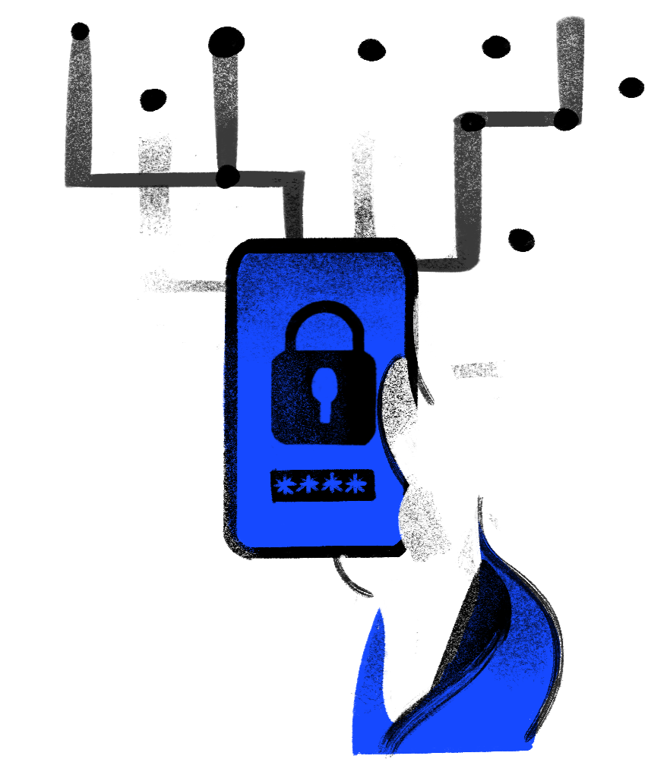
THANK
YOU

